Slide 1
Stats Moment
Binomial Distributions

Slide 2
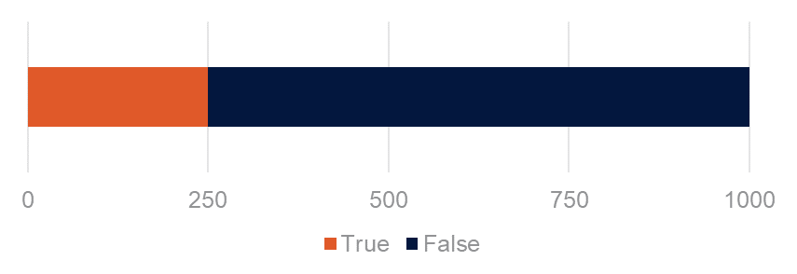
Binomial Distributions
Data containing discrete True/False, Yes/No, 1/0, or similar Boolean values are considered binomial
A number of data points (n) are accumulated into a statistic a proportion (p) or percentage
Normal average and standard deviation calculations are not appropriate for this type of data
Binomial distributions account for the fact that proportions (p) exist only in a confined range of 0% to 100%. Whereas, a normal distribution would allow for percentages that are negative or greater than 100%.
They also allow us to control for and compare proportions from different sample sizes (n)
When comparing proportions, similar to averages, we typically use a 95% confidence interval
p = 0.25 or 25%
n = 1,000

Slide 3
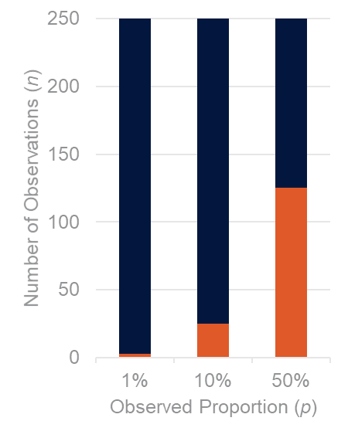
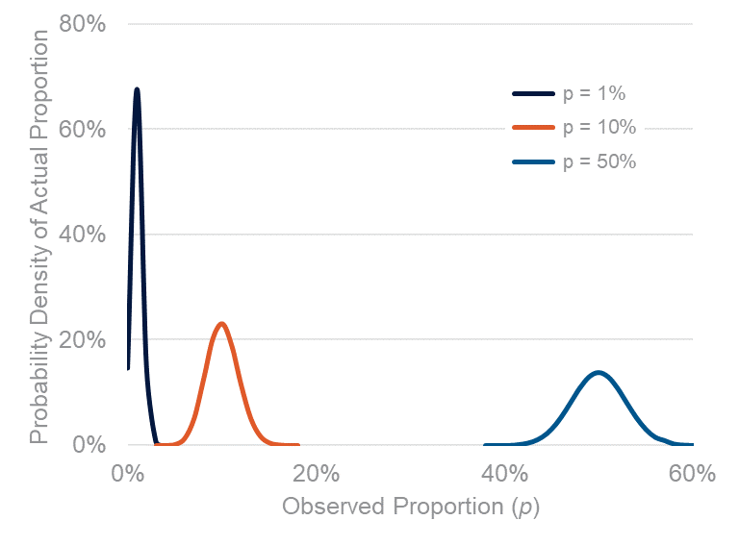
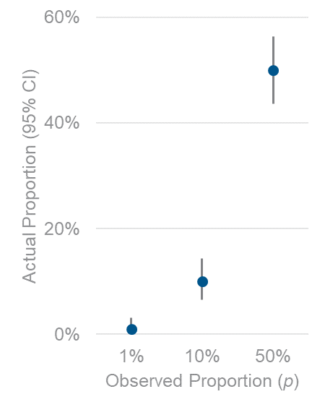
Binomial Distributions
For a given number of observations, confidence intervals are more narrow at the proportional extremes of 0% and 100%, and widest at 50%. Note how the distribution cannot exceed the range of 0% to 100%. This is the adjustment that binomial distributions provide that normal (Gaussian) distributions cannot account for with proportions.

Slide 4
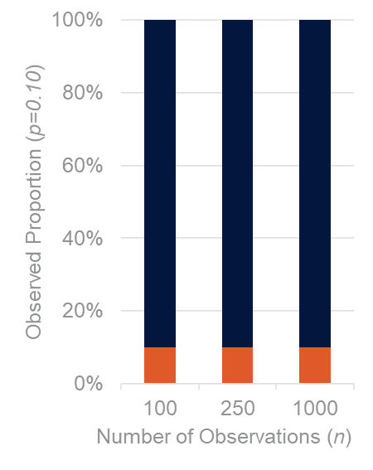
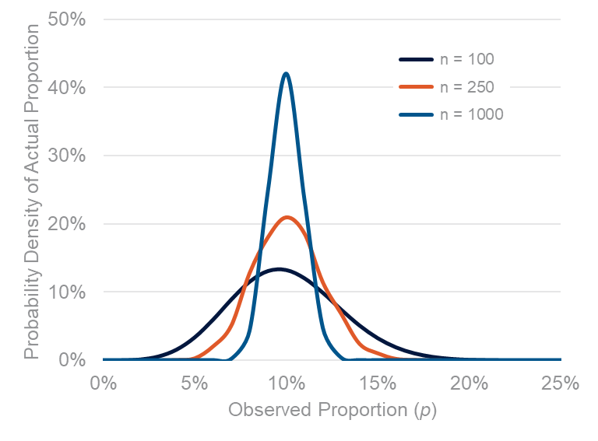
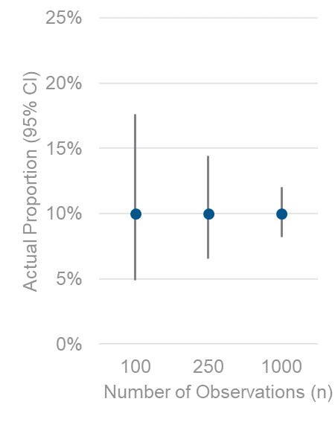
Binomial Distributions
For a given proportion, larger sample sizes result in more narrow confidence intervals. This is the exact same behavior that occurs in normal (Gaussian) distributions.

Slide 5
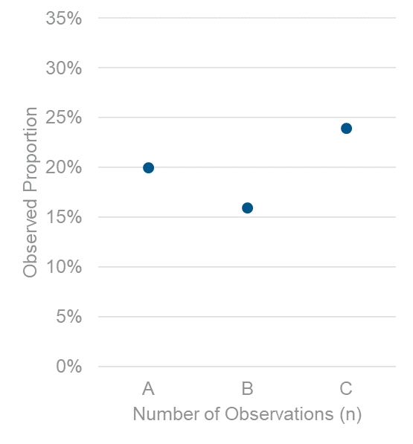
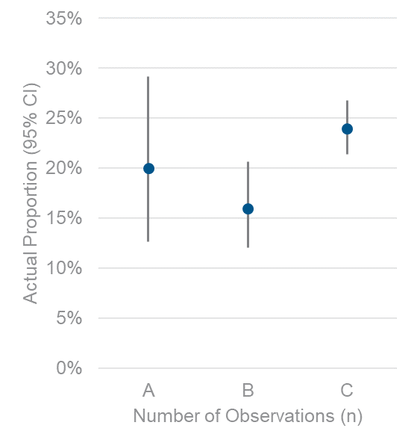
Comparing Binomial Distributions
Without Binomial Stats
With Binomial Stats
Examples | A | B | C
Number of Obs (n) | 100 | 300 | 1000
Positive Obs | 20 | 48 | 240
Proportion (p) | 20.0% | 16.0% | 24.0%
Upper 95% CI | 29.2% | 20.7% | 26.8%
Lower 95% CI | 12.7% | 12.0% | 21.4%
With binomial statistics we have the tools to compare proportions from different population sizes. For example: A & B as well as A & C overlap and therefore are not significantly different, but B & C do not overlap and therefore are different.

